Slide 1
GOES Coverage

Slide 2
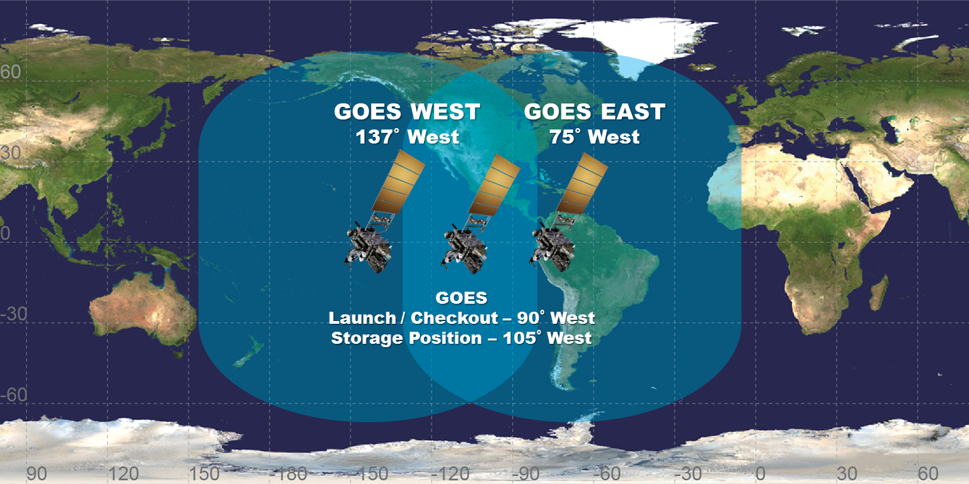
GOES Position and Coverage
The GOES satellites are geostationary over the equator
GOES-16 (East) is located at 75.2°W and GOES-17 (West) at 137.2°W
How much of the US is covered by their scanners?

Slide 3
2019 Coverage
(2019-10-27 17:00 UTC)

Slide 4
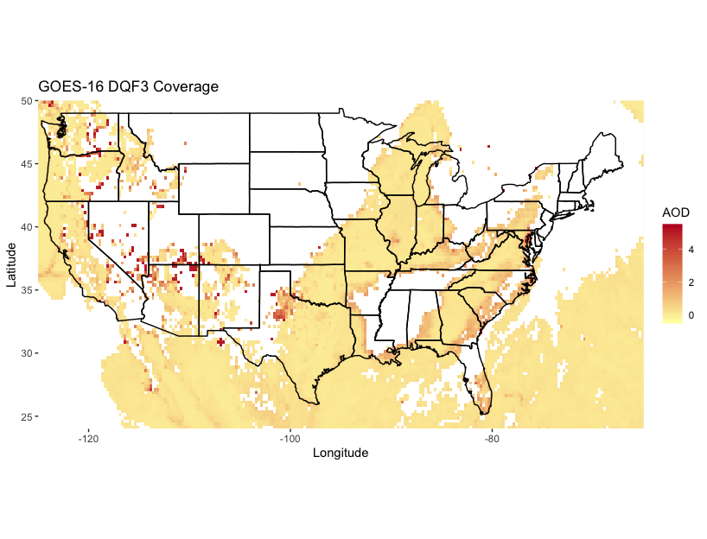

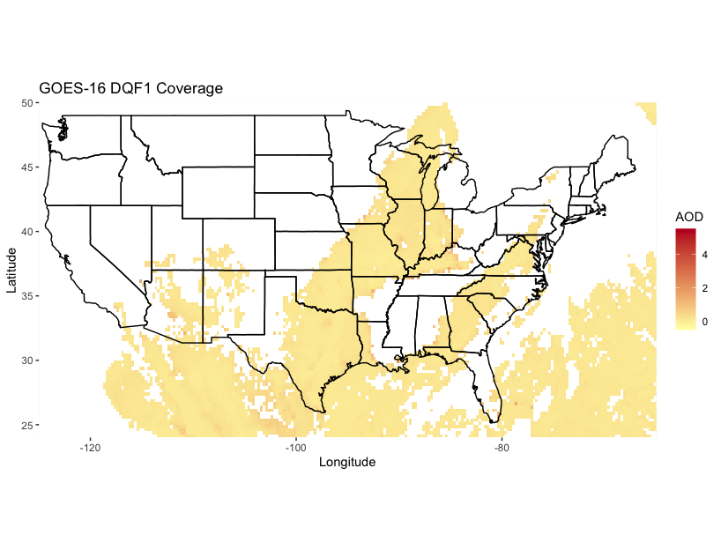
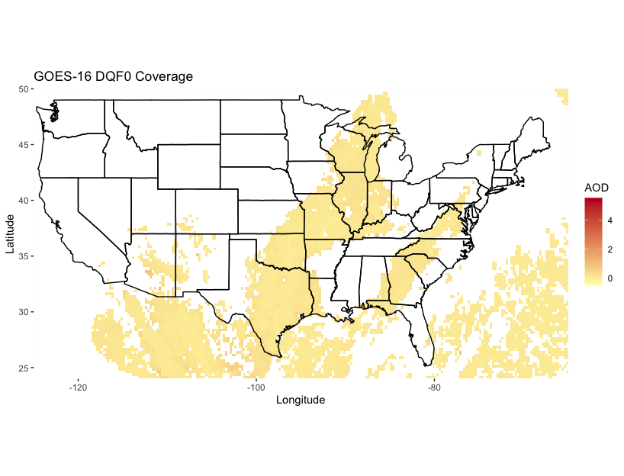
GOES-16 coverage (2019-10-27 10:00 PDT)

Slide 5
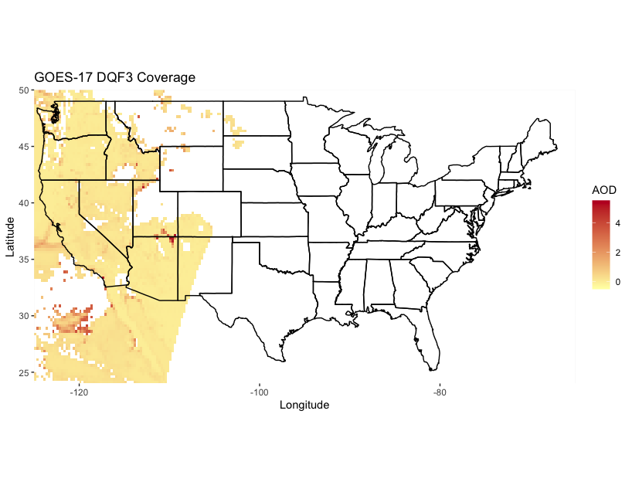

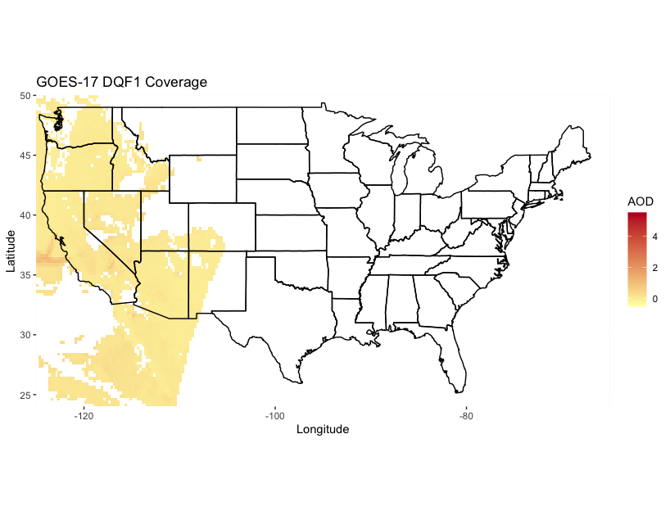
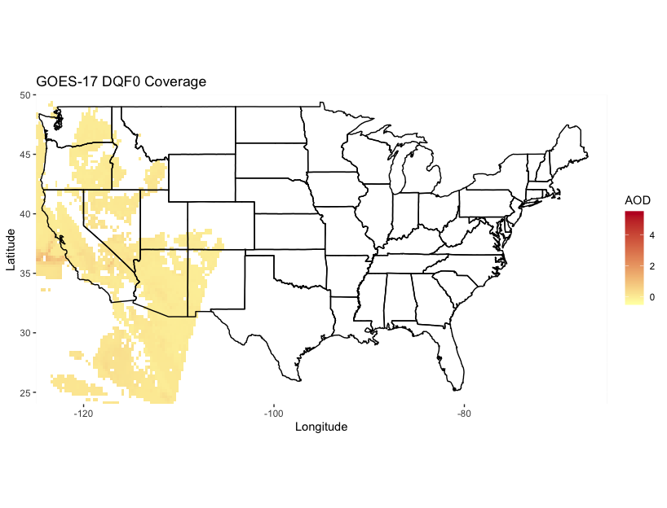
GOES-17 coverage (2019-10-27 10:00 PDT)

Slide 6
2021 Coverage
(2021-05-12 16:00 UTC)

Slide 7
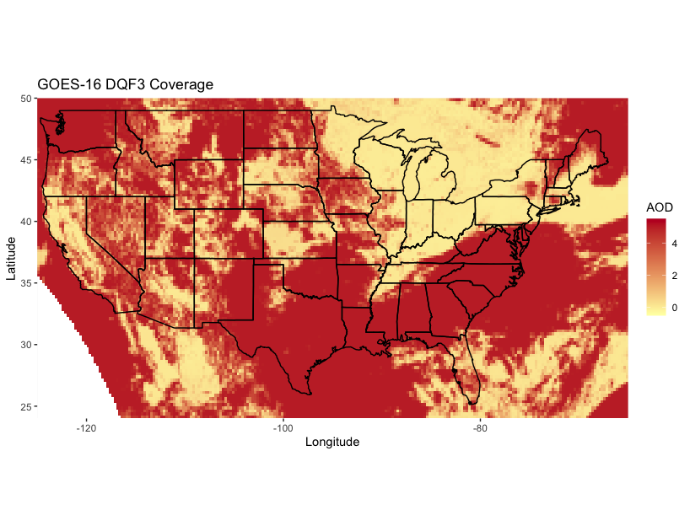
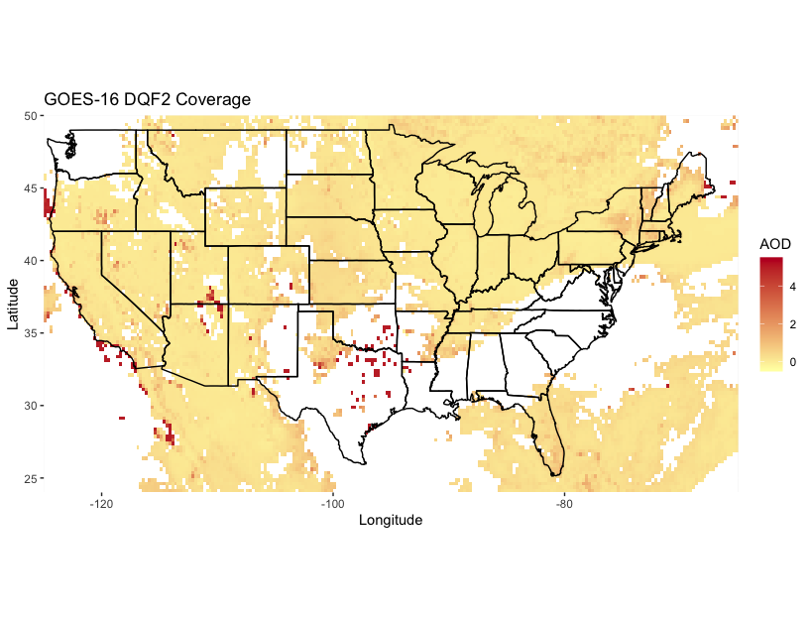
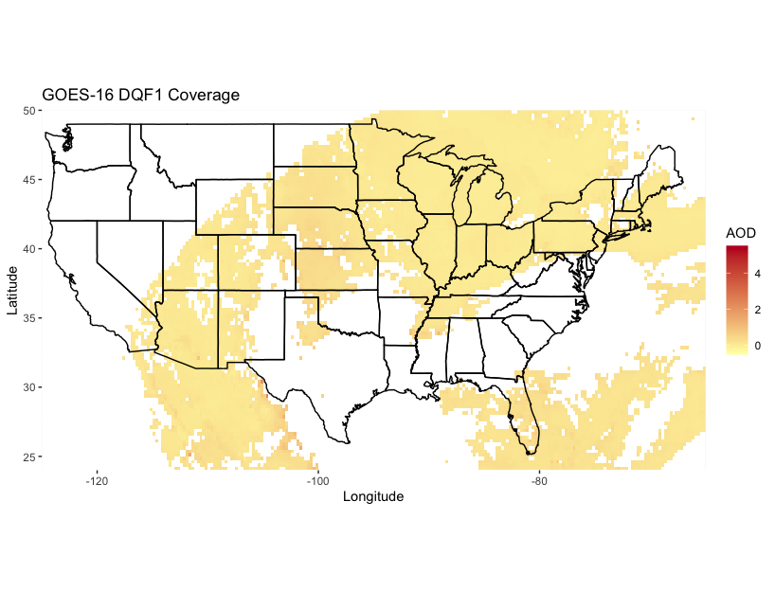
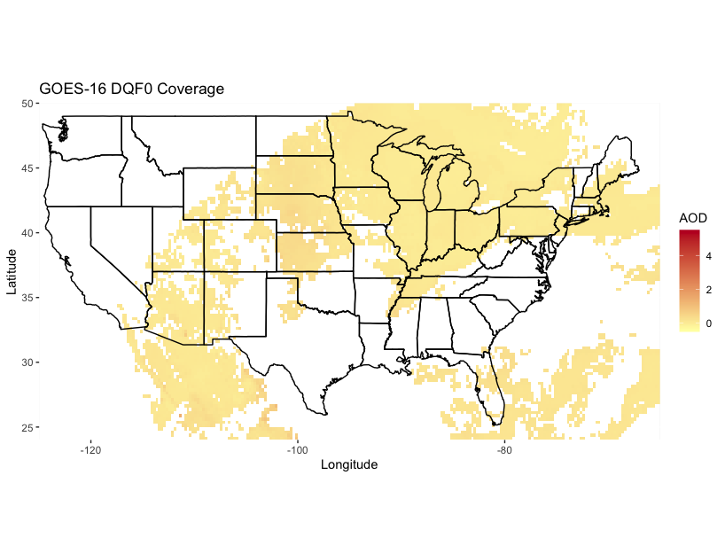
GOES-16 coverage (2021-05-12 09:00 CDT)

Slide 8
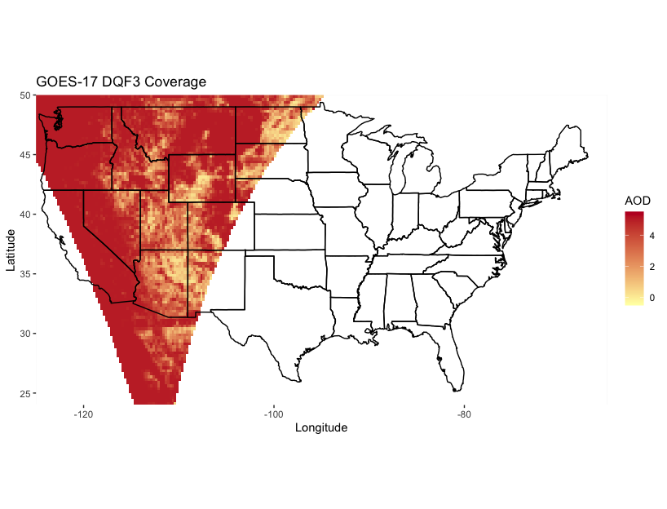
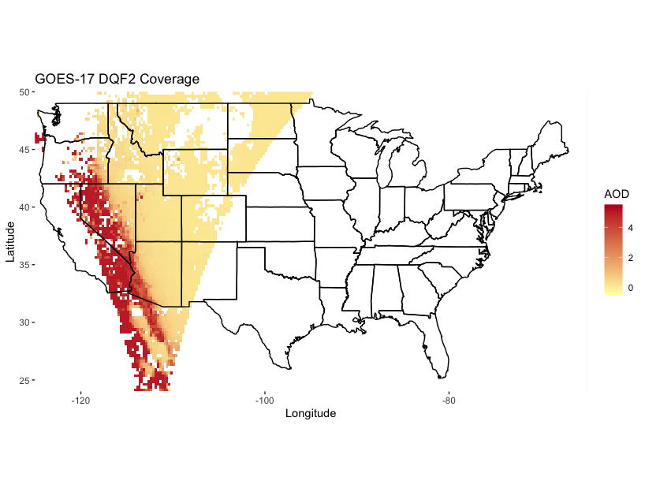
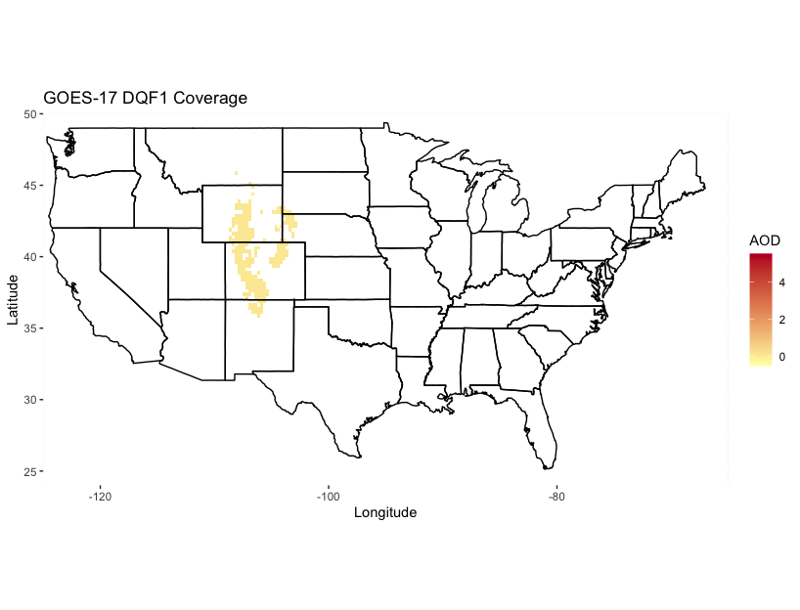
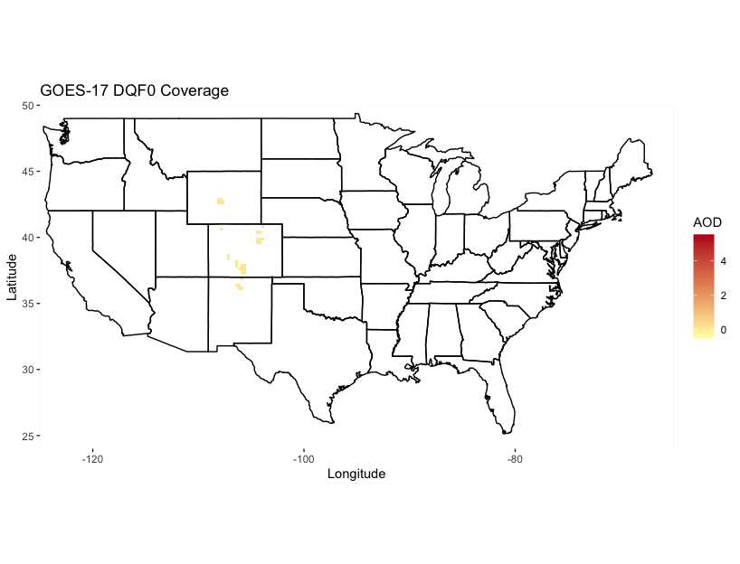
GOES-17 coverage (2021-05-12 09:00 CDT)

Slide 9
Combined GOES Coverage

Slide 10
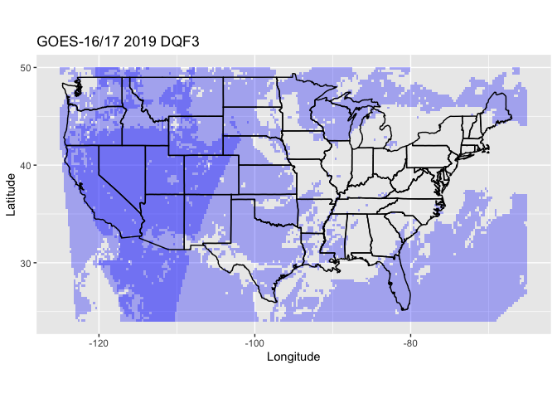
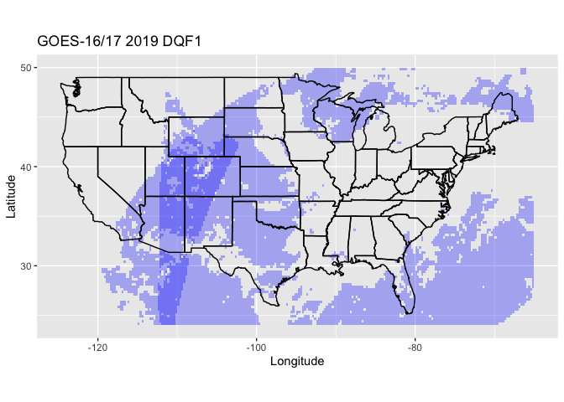
2019 Combined Coverage

Slide 11
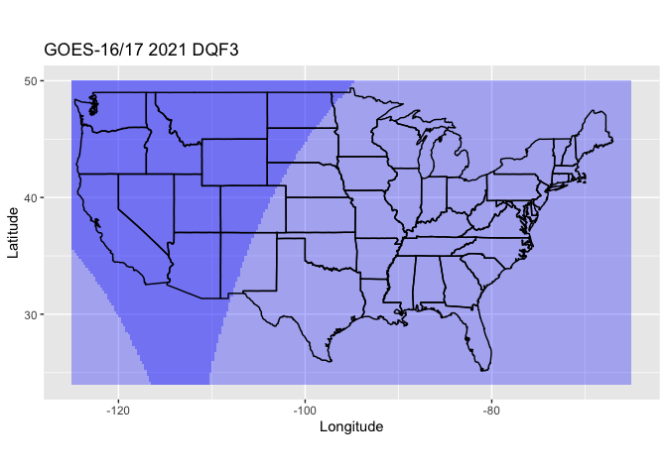
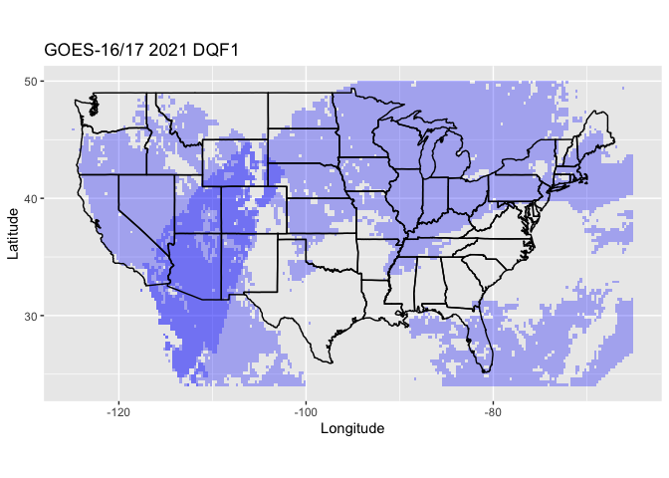
2021 Combined Coverage

Slide 12
Notes
Since 2019, the combined ranges of GOES-16/17 cover the entire CONUS when DQF >= 2.
When DQF < 2, no data is available for eastern Montana or western North Dakota.
Scans from 2019 (up to what date?) with DQF < 2 have no data for many of the western states.

